Slide 1
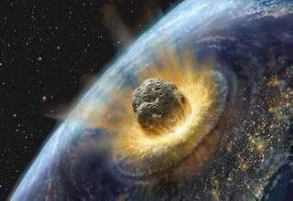
Art Impact: What Would Wetumpka Look Like Around The Time Of Impact? Wetumpka’s Inland Sea and Barrier Island Coastline

Slide 2
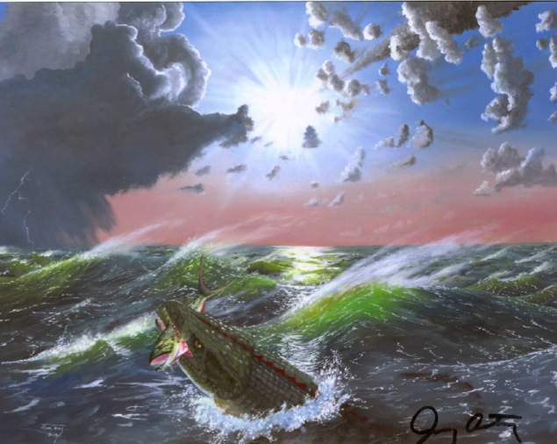
Before Impact: 83 Million Years Ago Wetumpka’s Inland Sea and Barrier Island Coastline
A marine reptile bites a fish in the Gulf of Mexico waters that covered central Alabama about 85 million years ago when the Wetumpka asteroid streaked through the sky.

Slide 3
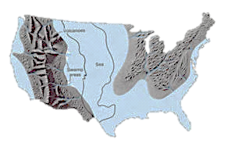
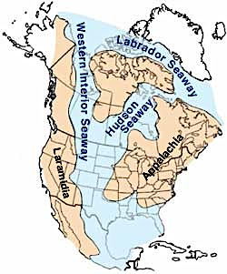
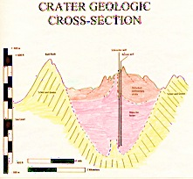
Wetumpka’s Inland Sea : Cretaceous Period
Mesozoic
During the Triassic and Jurassic periods, restless plates reactivated.
Texas and the parent continental plate pulled away from Pangaea opening the chasm for the Gulf.
The remains of the old Ouachita mountain range and Dallas were on the Texas gulf coast.
The rocks farther to the east and south warped downward and began to fill with sediment.
The Cretaceous was a particularly tectonically active period for the continent.
The Rockies had a major upward thrust and seas rose and fell continuously across the continent and Texas.
200 million years of geologic history wore down the North Texas highlands nearly flat, warped them downward, and buried them beneath thousands of feet of Cretaceous sediments.
A significant event for this time period was when the dinosaurs met their demise at the close of the Cretaceous (beginning of the Paleocene) 66 million years ago.

Slide 4
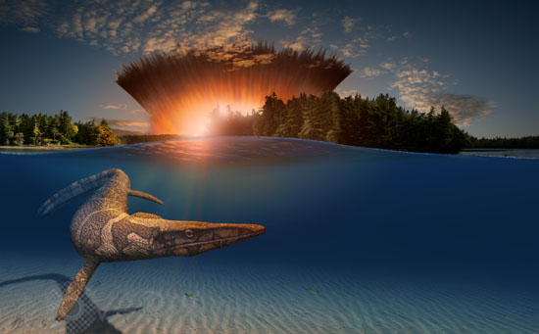
Artist Unknown

Slide 5
Artist Unknown

Slide 6
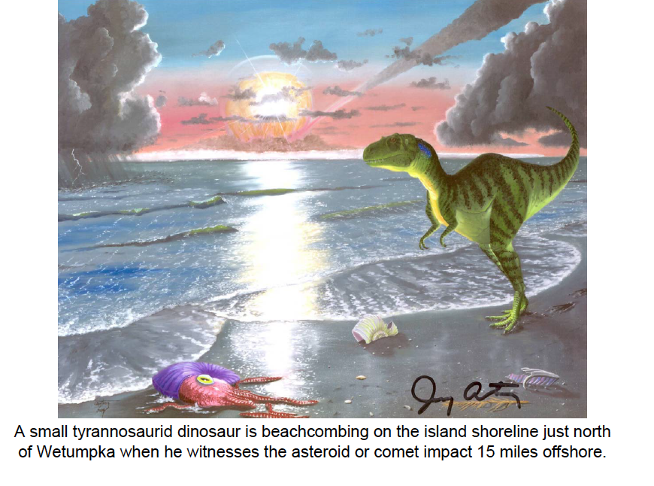

Slide 7
What is a Barrier Island?
Barrier islands, sometimes called barrier spits, are found on coastlines all over the world, but are most noticeable along the eastern coast of North America, where they extend from New England down the Atlantic Coast, around the Gulf of Mexico and south to Mexico.
Barrier islands are fragile, constantly changing ecosystems that are important for coastal geology and ecology.
Development has posed dangers to these ecosystems and has also increased the risk of property damage every year from hurricanes and Nor’easters.

Slide 8
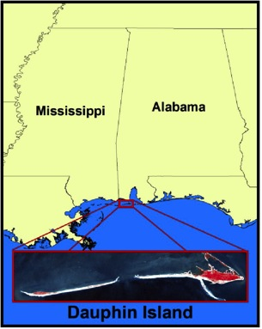
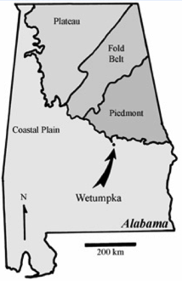
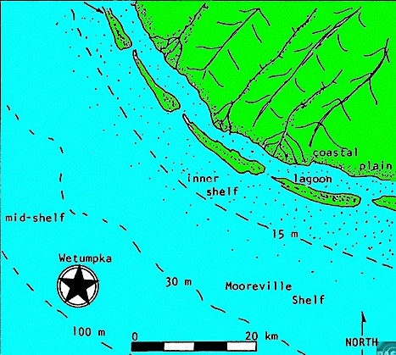
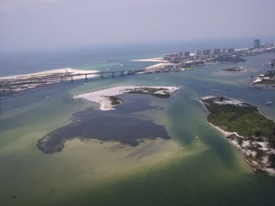
Wetumpka’s Barrier-Island Coastline
Wetumpka Impact Crater
*Above: Coastal Plain & Barrier Islands at the
Time of Impact
*Right & Above Right: Barrier Islands Today

Slide 9
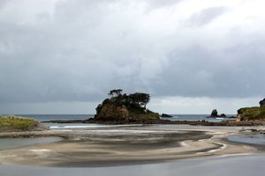
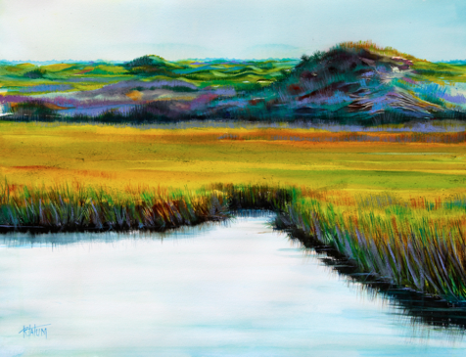
Barrier islands are long, narrow, offshore deposits of sand or sediments that parallel the coast line.
Some barrier islands can extend for 100 miles (160 km) or more.
The islands are separated from the main land by a shallow sound, bay or lagoon.
Barrier islands are often found in chains along the coast line and are separated from each other by narrow tidal inlets, such as the Outer Banks of North Carolina.

Slide 10
Formation of Barrier Islands
The formation of barrier islands is complex and not completely understood.
The current theory is that barrier islands were formed about 18,000 years ago when the last Ice Age ended.
As the glaciers melted and receded, the sea levels began to rise, and flooded areas behind the beach ridges at that time.
The rising waters carried sediments from those beach ridges and deposited them along shallow areas just off the new coast lines.
Waves and currents continued to bring in sediments that built up, forming the barrier islands.
In addition, rivers washed sediments from the mainland that settled behind the islands and helped build them up.
Barrier islands serve two main functions.
First, they protect the coastlines from severe storm damage.
Second, they harbor several habitats that are refuges for wildlife

Slide 11
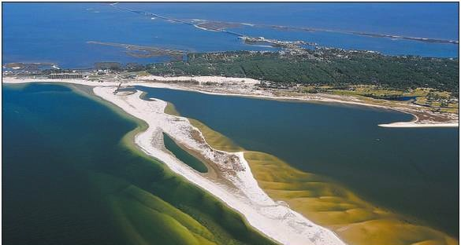
Bill Starling’s Photograph Illustrates How Alabama’s Sand Island is connected to Dauphin Island

Slide 12
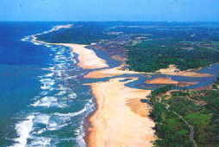
Barrier Island Zones
Beach - consists of sand deposited by the actions of waves
Dunes - formed from sand carried and deposited by winds. Dunes are stabilized naturally by plants (sea oats, bitter pancum) and artificially by fences. The primary dune faces the ocean and may be followed by secondary and tertiary dunes inland.
Barrier flat - (also called backdune, overwash or mud flat) formed by sediments that get pushed through the dune system by storms, such as hurricanes. Grasses grow and stabilize these areas.
Salt marsh - a low-lying area on the sound-side of a barrier island. Salt marshes are generally divided into high and low marsh areas. High marsh areas get flooded twice each month with the spring tides, while low marsh areas get flooded twice daily with the high tides. Cord grasses stabilize the salt marsh area, which are one of the most ecologically productive areas (amount of vegetation per acre) on Earth. In fact, the salt marsh ecosystems of the islands and the coast help to purify runoffs from mainland streams and rivers.

Slide 13
Typical Barrier Island

Slide 14
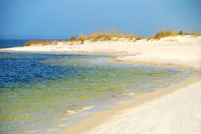
Barrier Island Habitats
Beach Habitat
On the ocean side is the barrier island's beach habitat. The beach is much like a desert in that it lacks fresh water, but a large portion of the beach gets covered almost entirely with salt water twice daily (the entire beach gets covered to the dune base during storms).
Animals and plants in this environment (known as the intertidal zone, between tides) must endure long periods of exposure to salt water and drying air.
On the beach, the only plant life you'll see is some algae that get washed ashore.
Bacteria live in the spaces between the sand grains where water from the surf percolates through.
The animals on the beach itself include burrowing animals like mole crabs and clams that filter-feed during high tides, burrowing worms that feed on bacteria in the sand, scavenging crabs (ghost crabs) and various shorebirds (sandpipers, seagulls and pelicans) that eat the crabs, burrowing animals and offshore fish.

Slide 15
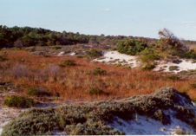
Barrier Island Habitats
Dune Habitat
The dunes receive moisture from rain and surf and are occasionally flooded during severe storms.
The dunes are still a relatively hostile environment with high salt content, sandy soil and little fresh water.
Plants such as sea oats and bitter pancum provide stability to the dunes. Their root systems hold the sand in place and their shoots slow the winds, thereby allowing sand to be deposited.
Along the dunes, you will find many crabs, particularly ghost crabs. Again, you will find birds (gulls, terns) that feed on the animals that inhabit the dunes.
After the dunes, some islands may have maritime forests with shrubs and trees (Sand Live Oak, Myrtle Oak, Slash Pine and Magnolia). Animals in these forests include various snakes, opossums, skunk, raccoon and fox.

Slide 16
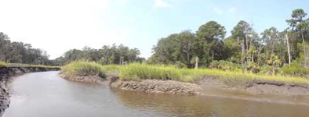
Barrier Island Habitats
Barrier-flat Habitat
On other islands, the barrier flats come after the dunes.
The primary vegetation includes cordgrass and sawgrass. These areas are often flooded daily during high tides.
The muds and sediments are full of anaerobic bacteria (there is little oxygen in the sediments). The bacteria decompose the rich organic material in the sediments and from dead plants and animals.
Animals that live in the wet muds filter-feed bacteria and plankton from the tidewaters or feed on bacteria in the muds; these animals include clams, mussels, snails and worms.
Various fish come and go with the tides. Fiddler crabs feed on the bacteria in the muds. Ghost crabs and blue crabs feed on the bacteria, small invertebrates and small fish. Various birds (seagulls, egrets, pelicans) feed on the fish, crabs and invertebrates.

Slide 17
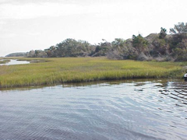
Barrier Island Habitats
Salt-marsh Habitat
The sound-side of an island is usually dominated by the salt marsh.
The salt marshes that you find on the sound sides of barrier islands are similar to those found on the coastal mainland.
Like the barrier flats, salt marshes are regularly flooded with seawater during high tide and the animals and plants that you find are similar to those in the barrier flats.

Slide 18
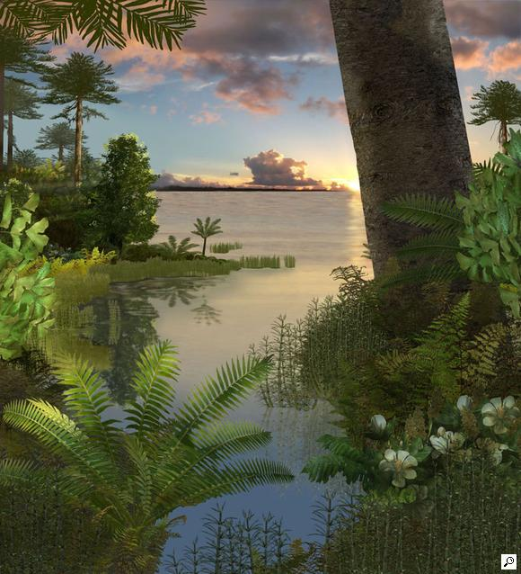
Artist Interpretations: Karen Carr

Slide 19
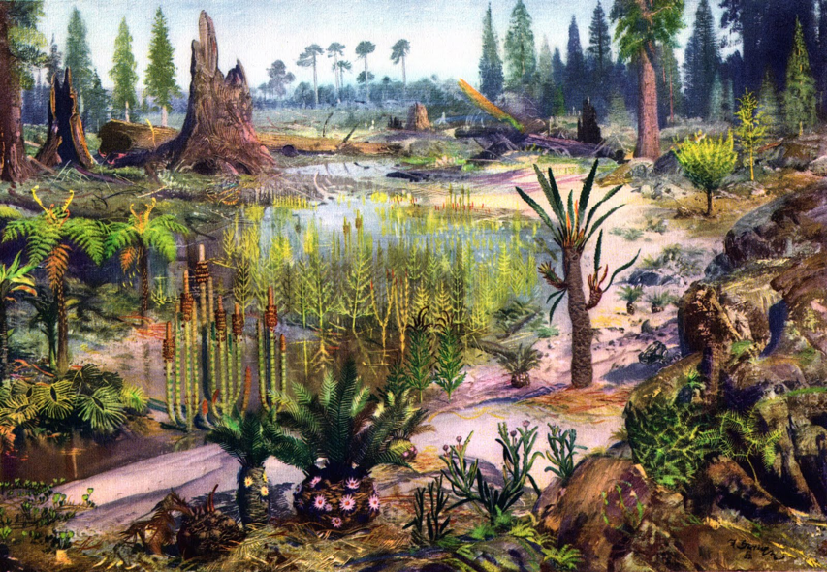
Artist Interpretations: Zdenek Burian

Slide 20
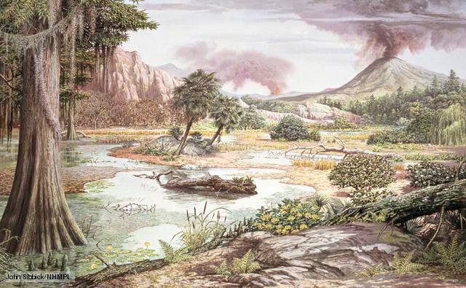
Artist Interpretations: John Sibbick

Slide 21
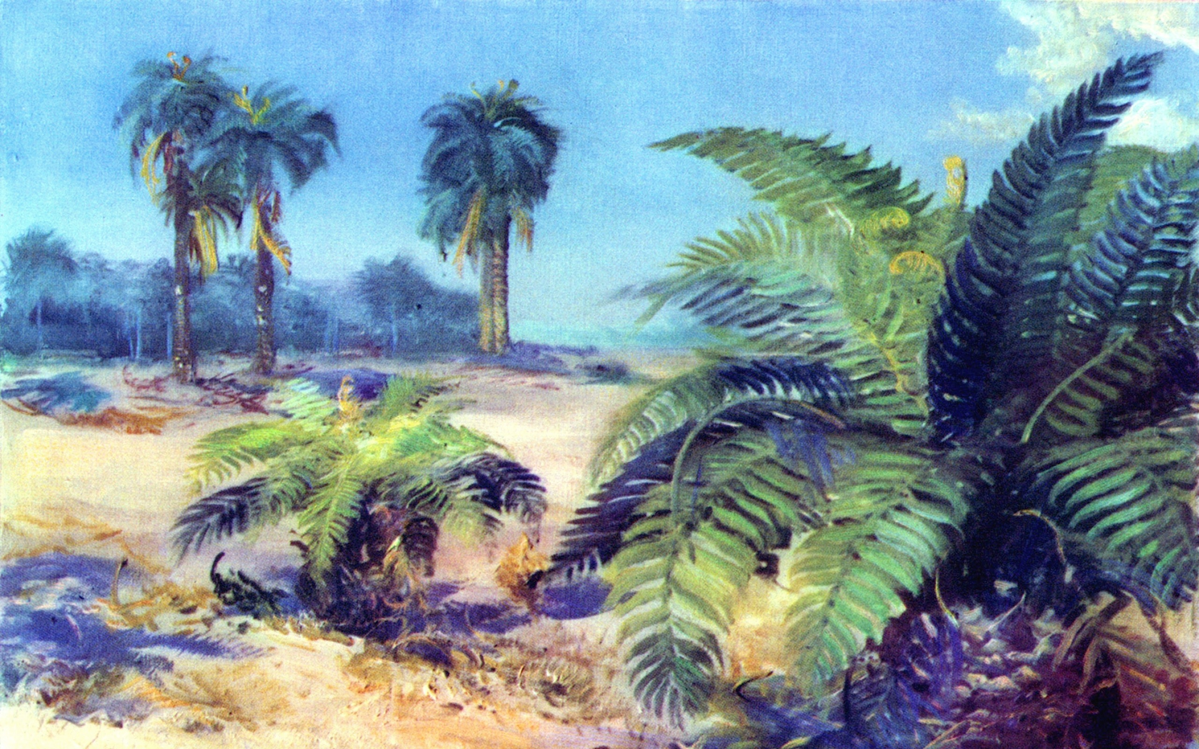
Artist Interpretations: Zdenek Burian

Slide 22
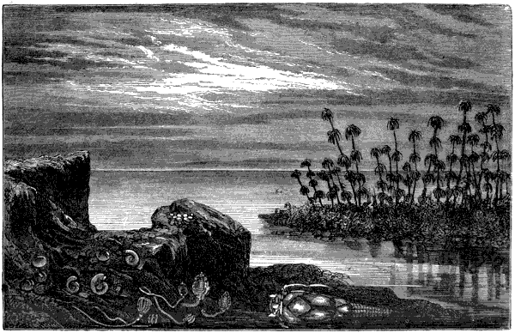
Artist Interpretations: Historical Drawing

Slide 23
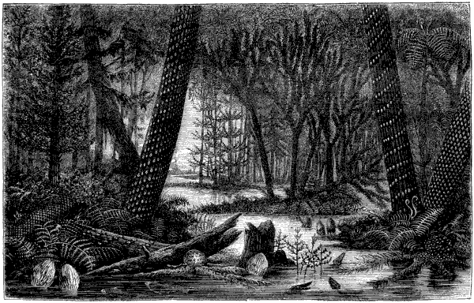
Artist Interpretations: Historical Drawing

Slide 24
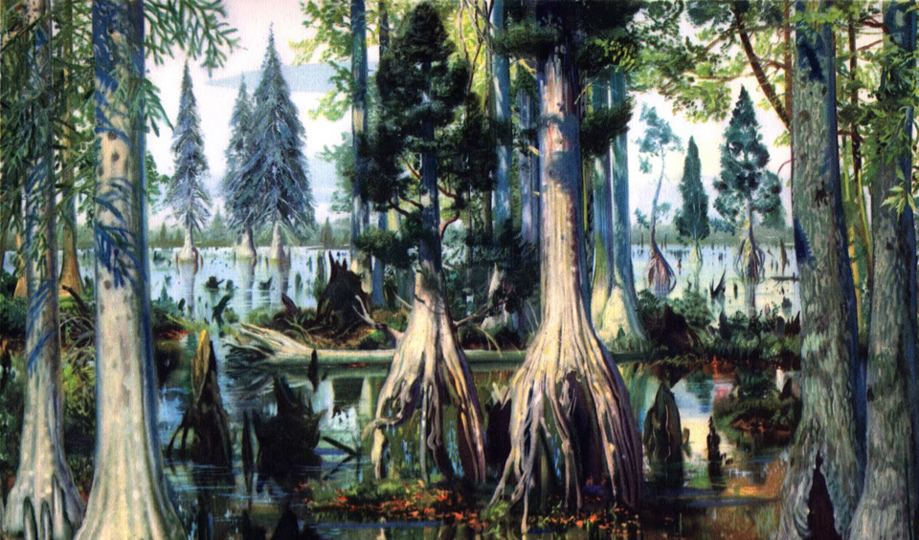
Artist Interpretations: Zdenek Burian

Slide 25
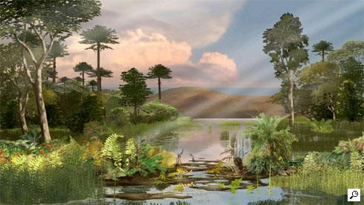
Artist Interpretations: Karen Carr

Slide 26
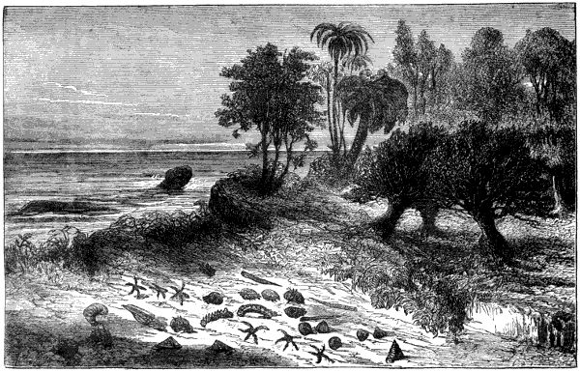
Artist Interpretations: Historical Drawing

Slide 27
Additional Resources
Dauphin Island
Discovering Alabama, Dr. Doug Phillips
To view the Dauphin Island Video:
https://itunes.apple.com/us/itunes-u/discovering-alabama-videos/id383699006?mt=10
The click on episode #46

Slide 28
Image Licenses and Copyright of work
Please note: All images shown are governed by copyrights in the United States and in all nations of the International Copyright Union. All rights are reserved. No images may be reproduced without written permission.
Some images are governed by existing copyright agreements with museums or other institutions.
The paintings and drawings by the artists in this presentation are intended to illustrate ideas, concepts and themes for educational purposes.
According to the United States Copyright Office, works may not be simply copied by another person in any manner, this includes: photography or by the hand of another person such as drawing, painting or any two or three-dimensional medium.
Educationally, copying another persons work is stealing and constitutes plagiarism.
We encourage students and artists to use the images for educational purposes in order to create their own unique compositions. Works that are direct copies of another artist’s work will not be accepted.

Slide 29
Art Impact: The Wetumpka Impact Crater Create Your work of art & Enter the Contest! Entries Due on or before Thursday, January 15, 2015.

Slide 30
Citations
Powerpoint 4: Barrier Islands, The Wetumpka Impact Crater
Slide 2: Jerry Armstrong, The Wetumpka Impact Crater Commission
Slide 3: http://www.nhnct.org/geology/geohist.html
Slide 6: Jerry Armstrong, The Wetumpka Impact Crater Commission
Slide 7: National Oceanic and Atmospheric Administration - www.csc.noaa.gov/.../...
Slide 9 – 10: National Oceanic and Atmospheric Administration - www.csc.noaa.gov/.../...
Slide 11: Bill Starling
Slide 12 – 17: Slide 7: National Oceanic and Atmospheric Administration - www.csc.noaa.gov/.../...
Slide 18: Karen Carr
Slide 19: Zdenek Burian
Slide 20: John Sibbick
Slide 21: Zdenek Burian
Slide 24: Zdenek Burian
Slide 25: Karen Carr

